Slide 1
DevOps Intern Technical Assessment
AWS |Terraform | Docker | Kubernetes | Grafana | Loki
Mansi Patil

Slide 2
Contents
1.
Infrastructure Provisioning using Terraform
2.
Application Deployment using Docker + Kubernetes
3.
Ingress-based routing
4.
Observability using Prometheus + Grafana + Loki
5.
Debugging production issues
6.
Final project deployed on AWS EKS

Slide 3
Tools
Terraform: VPC, Subnets, NAT, EKS
Docker: Built backend & frontend images
Kubernetes: Deployment, Service, Ingress
AWS EKS: Managed Kubernetes
Grafana: Metrics dashboards
Loki: Log aggregation

Slide 4
Terraform Infrastructure
Created AWS VPC
Public + Private subnet
Internet Gateway ,NAT gateway
Route table for public and private routing
IAM roles for EKS
S3 bucket + DynamoDB table for Terraform backend
EKS Cluster + Node Group deployed via Terraform

Slide 5
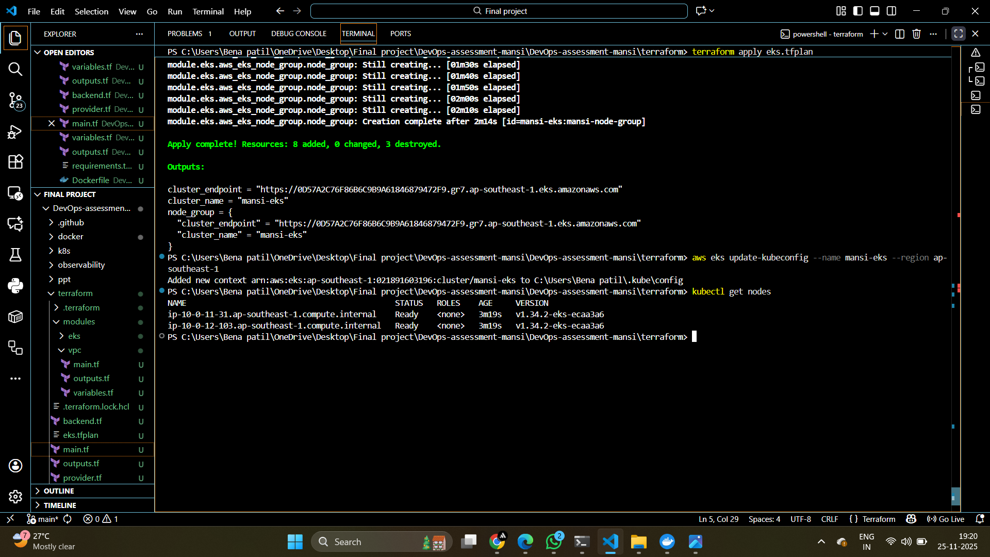

Slide 6
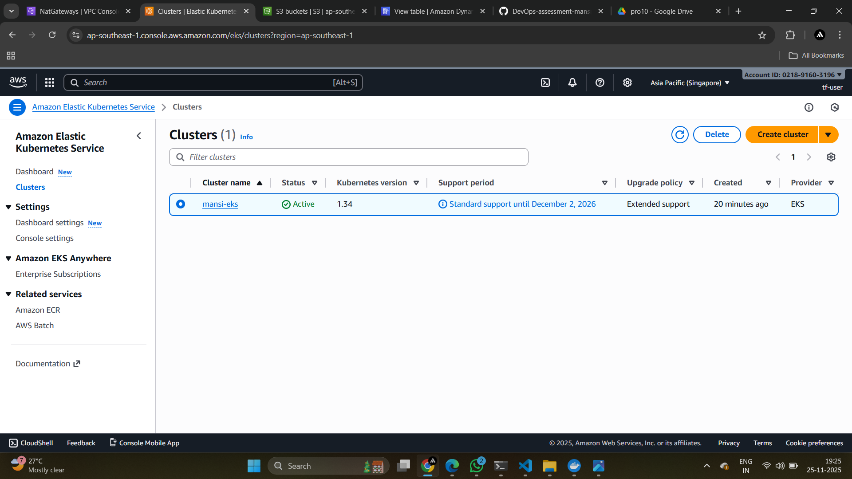

Slide 7
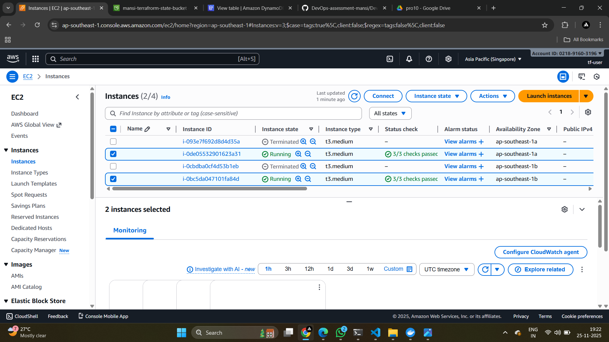

Slide 8
Backend Application
Build Python backend (app.py)
Endpoints /api, /health, /metrics
Created Dockerfile
Push image to DockerHub
Created backend deployment + cluster IP service
Frontend Application
Simple Nginx-based frontend
Calls backend using /api
Dockerfile added
DockerHub image uploaded
Created frontend Deployment + LoadBalancer Service

Slide 9
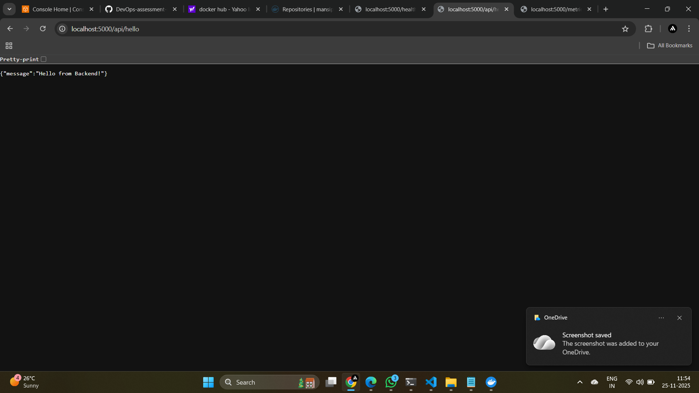

Slide 10
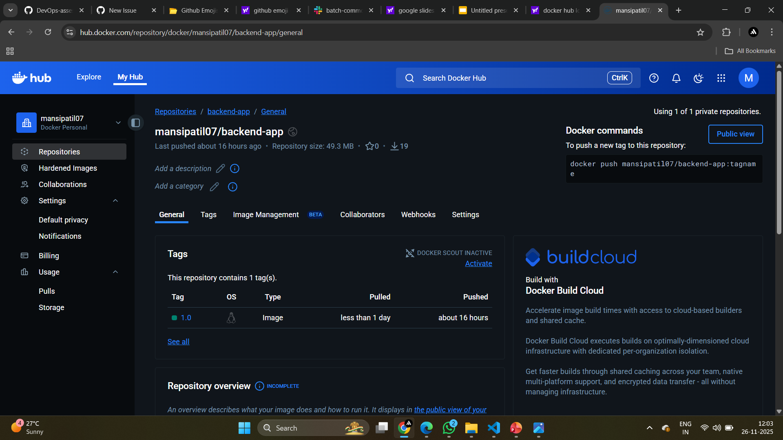

Slide 11


Slide 12
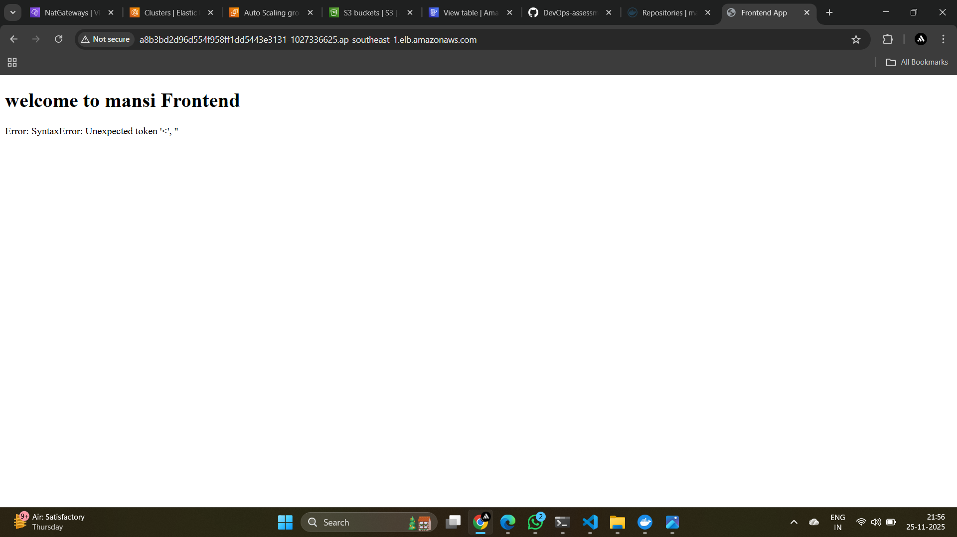

Slide 13
Ingress Controller
Install Nginx Ingress via helm
Create ingress rules
/ frontend
/api backend

Slide 14
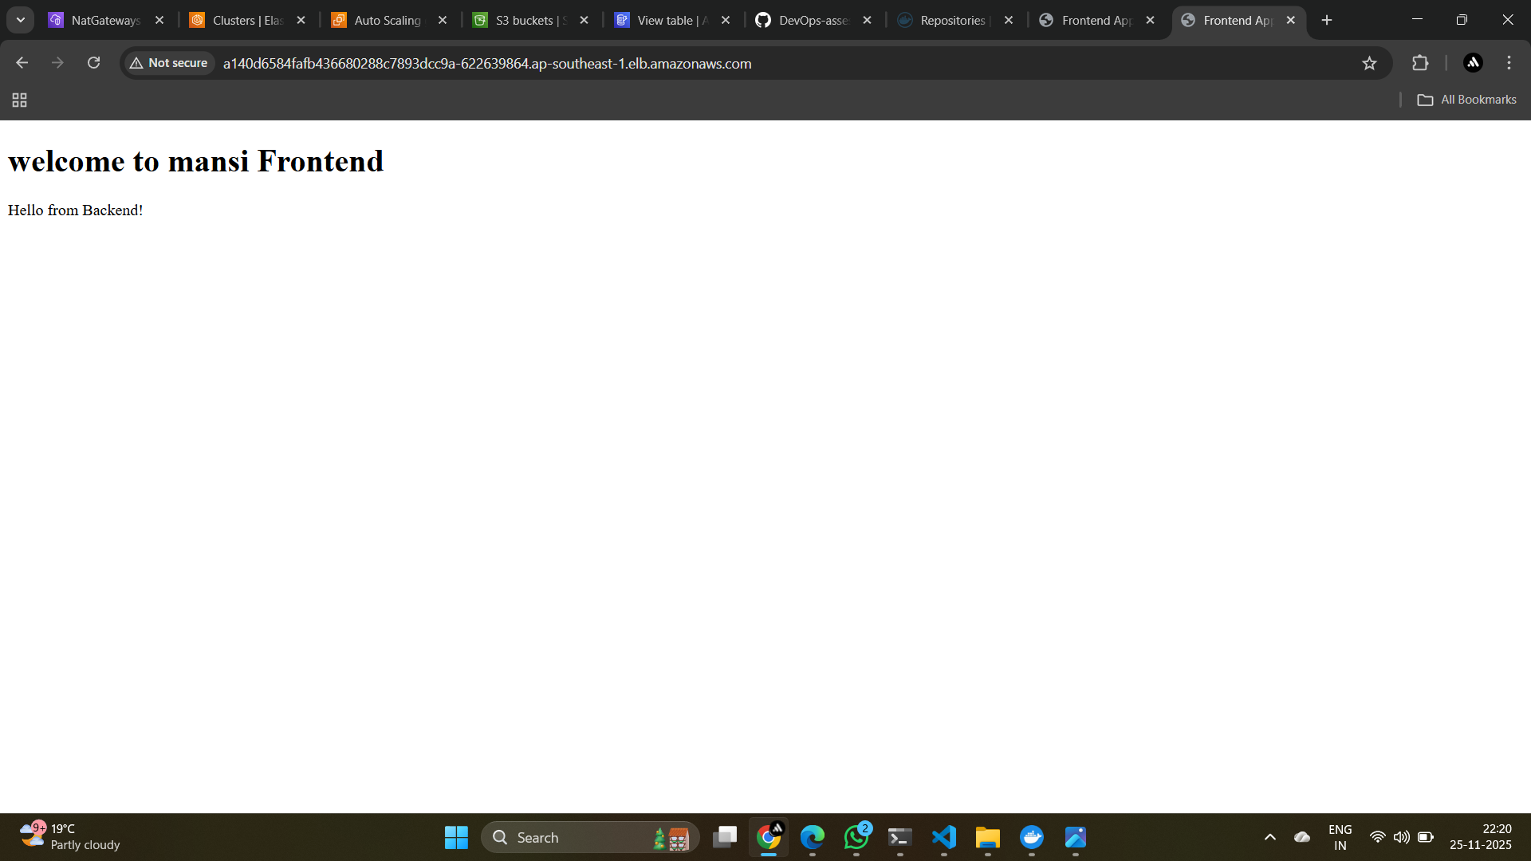

Slide 15
apiVersion: networking.k8s.io/v1
kind: Ingress
metadata:
name: app-ingress
namespace: mansi-app
annotations:
nginx.ingress.k8s.io/rewrite-target: /
spec:
ingressClassName: nginx
rules:
- http:
paths:
- path: /
pathType: Prefix
backend:
service:
name: frontend-service
port:
number: 80
- path: /api
pathType: Prefix
backend:
service:
name: backend-service
port:
number: 5000

Slide 16
Monitoring and Logging
Install prometheus using helm
Install Grafana
Added Grafana datasource
Build dashboard
Pod CPU/Memory
Node usage
API latency
Logs Explore

Slide 17
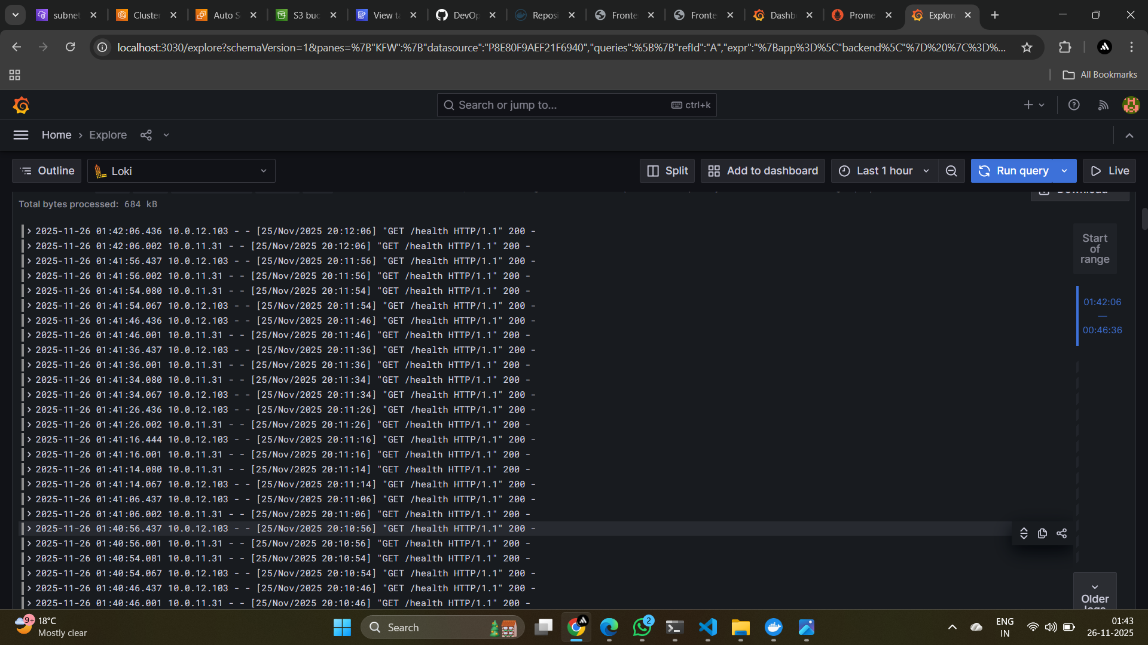

Slide 18
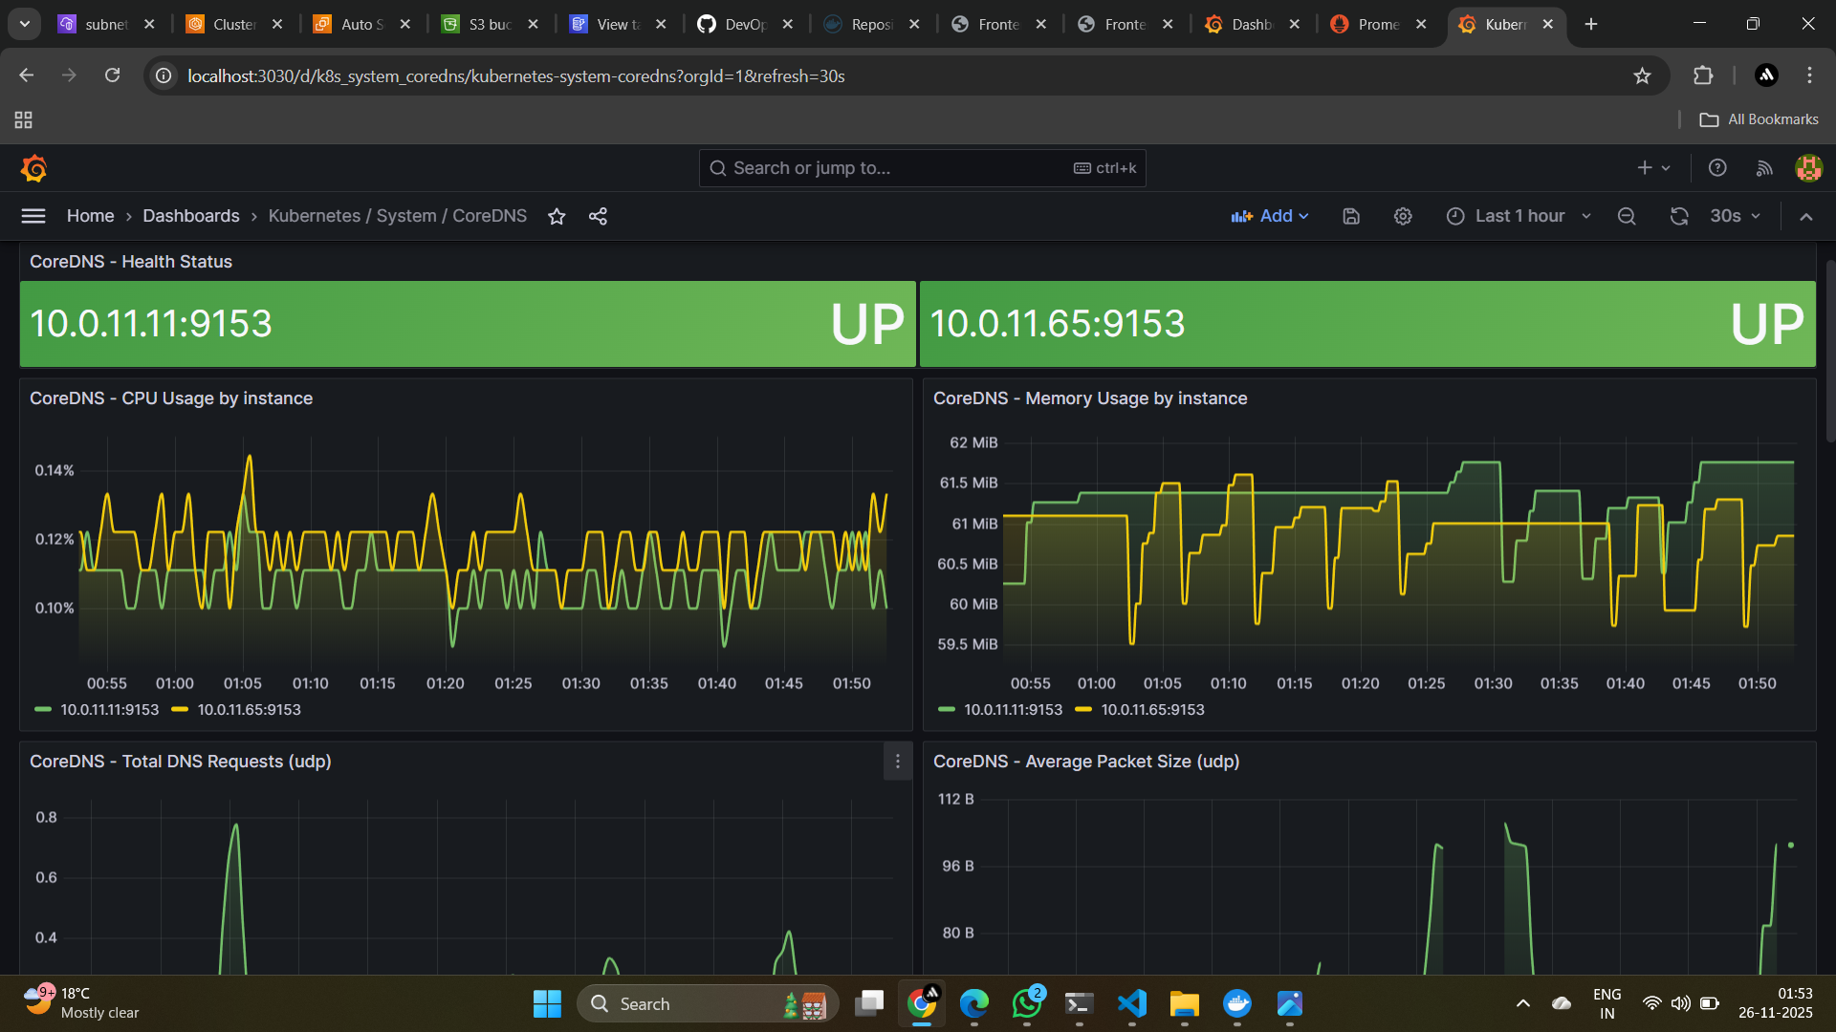

Slide 19
Debugging Section
CrashLoopBackOff
Issue: Wrong command (main.py instead of app.py)
Fix: Updated command in deployment file
Ingress Route Failure
Issue: Frontend calling /backend, backend exposed /api
Fix: Updated ingress path
Terraform S3 Backend Error
Issue: Missing S3 bucket + DynamoDB
Fix: Created required backend resources
Logging Not Working
Issue: Wrong log path (*.logx)
Fix: Updated to *.log

Slide 20
Key Learning
Deep understanding of Terraform modules
EKS networking (public/private subnets, NAT)
Monitoring and log collection on production-grade cluster
Kubernetes deployments, services, ingress
Debugging real-world DevOps issues

Slide 21
Challenges
NAT gateway + private subnets
Kibana installation failed → switched to Loki
Port-forwarding issues on PowerShell
Grafana login password extraction
Backend-Frontend connectivity via Ingress

Slide 22
Thank you

